Slide 1
Digital Forensics Trends for 2020
By
Saket Thombre

Slide 2
Agenda
Types of CyberCrime
Malware
The COVID Era
Threats
Forensics
Key Challenges in Digital Forensics
Digital Forensics of Tomorrow
Cyber Hygiene

Slide 3
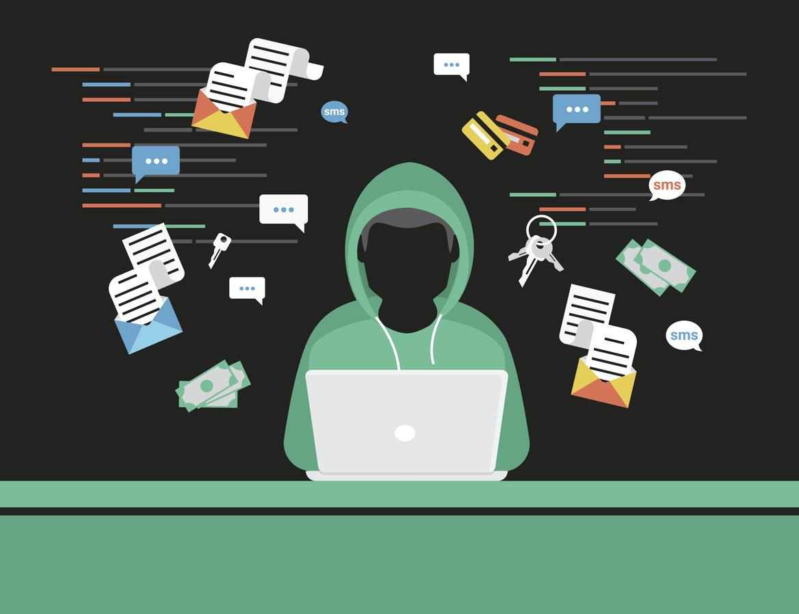
What is Cyber Crime?
Cybercrime, or computer-oriented crime, is a crime that involves a computer and a network.
The computer may have been used in the commission of a crime, or it may be the target.

Slide 4
Types of CyberCrime
Cybercrime is defined as a crime where a computer is the object of the crime or is used as a tool to commit an offense.
Cyber Crimes are generally divided into 2 sub categories
Crimes that target networks or devices.
Malware
DoS Attacks
Crimes using devices to participate in criminal activities
Spam
Identity Theft

Slide 5
What are Malware?
Malware is any software intentionally designed to cause damage to a computer, server, client, or computer network.
Types of Malware Include:
Virus
Worm
Ransomware
Trojan
Spyware
Adware
etc..

Slide 6
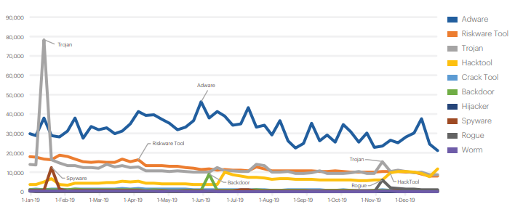
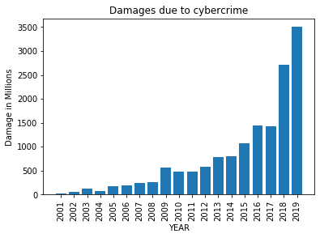
How has Malware Affected Us?
Malwares detected in consumer category for 2019-20
Damages Due to Cyber Crime in millions
Source: malwarebytes.com

Slide 7
Virus and Worms
Worms
A computer worm is a type of malware that spreads copies of itself from computer to computer. A worm can replicate itself without any human interaction, and it does not need to attach itself to a software program in order to cause damage.
Virus
A computer virus is a type of malicious code or program written to alter the way a computer operates and is designed to spread from one computer to another. Virus has the potential to cause unexpected or damaging effects, such as harming the system software by corrupting or destroying data.

Slide 8
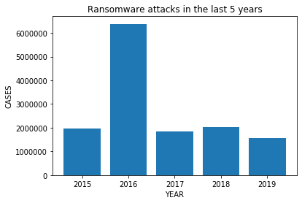

Ransomware
Ransomware is a form of malware that encrypts a victim's files. The attacker then demands a ransom from the victim to restore access to the data upon payment.

Slide 9
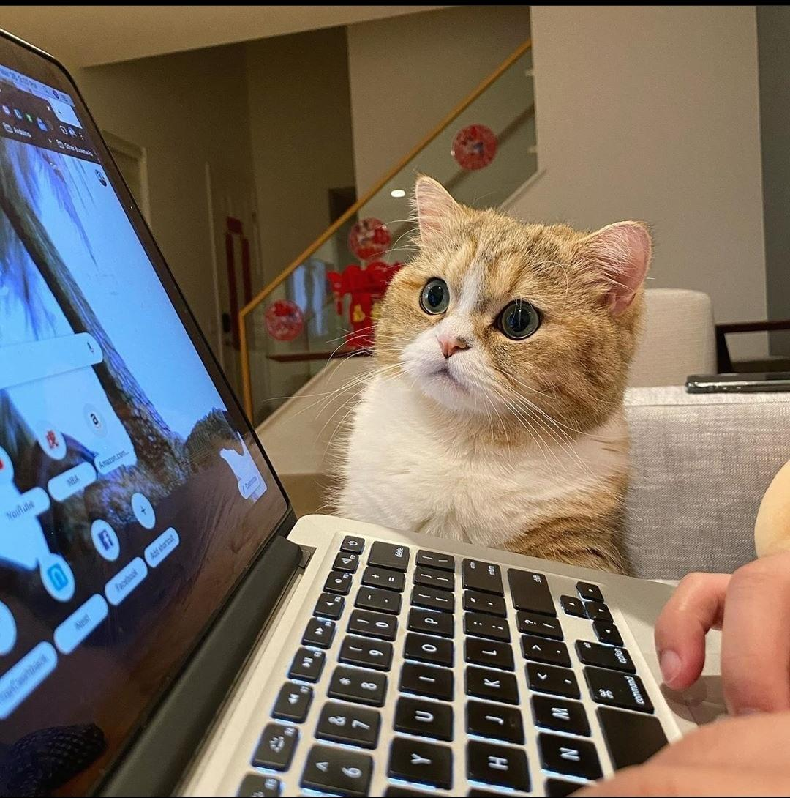
Trojans and Spyware
Trojans
A Trojan horse, or Trojan, is a type of malicious code or software that looks legitimate but can take control of your computer. A Trojan is designed to damage, disrupt, steal, or in general inflict some other harmful action on your data or network.
Spyware
Spyware is unwanted software that infiltrates your computing device without your knowledge, stealing your internet usage data and sensitive information.

Slide 10
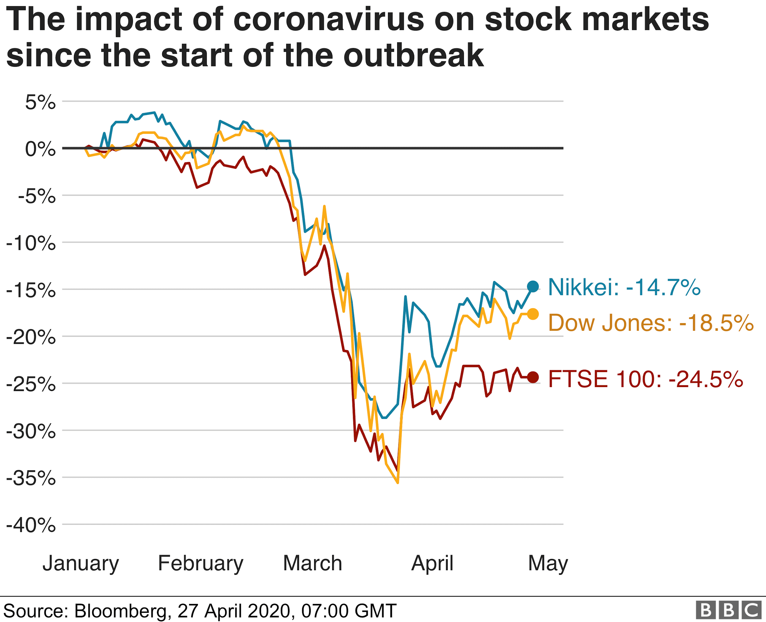

The COVID Era
Impacted all Sectors around the world.
Work from home
Social Distancing
Self-Isolation
Quarantine

Slide 11
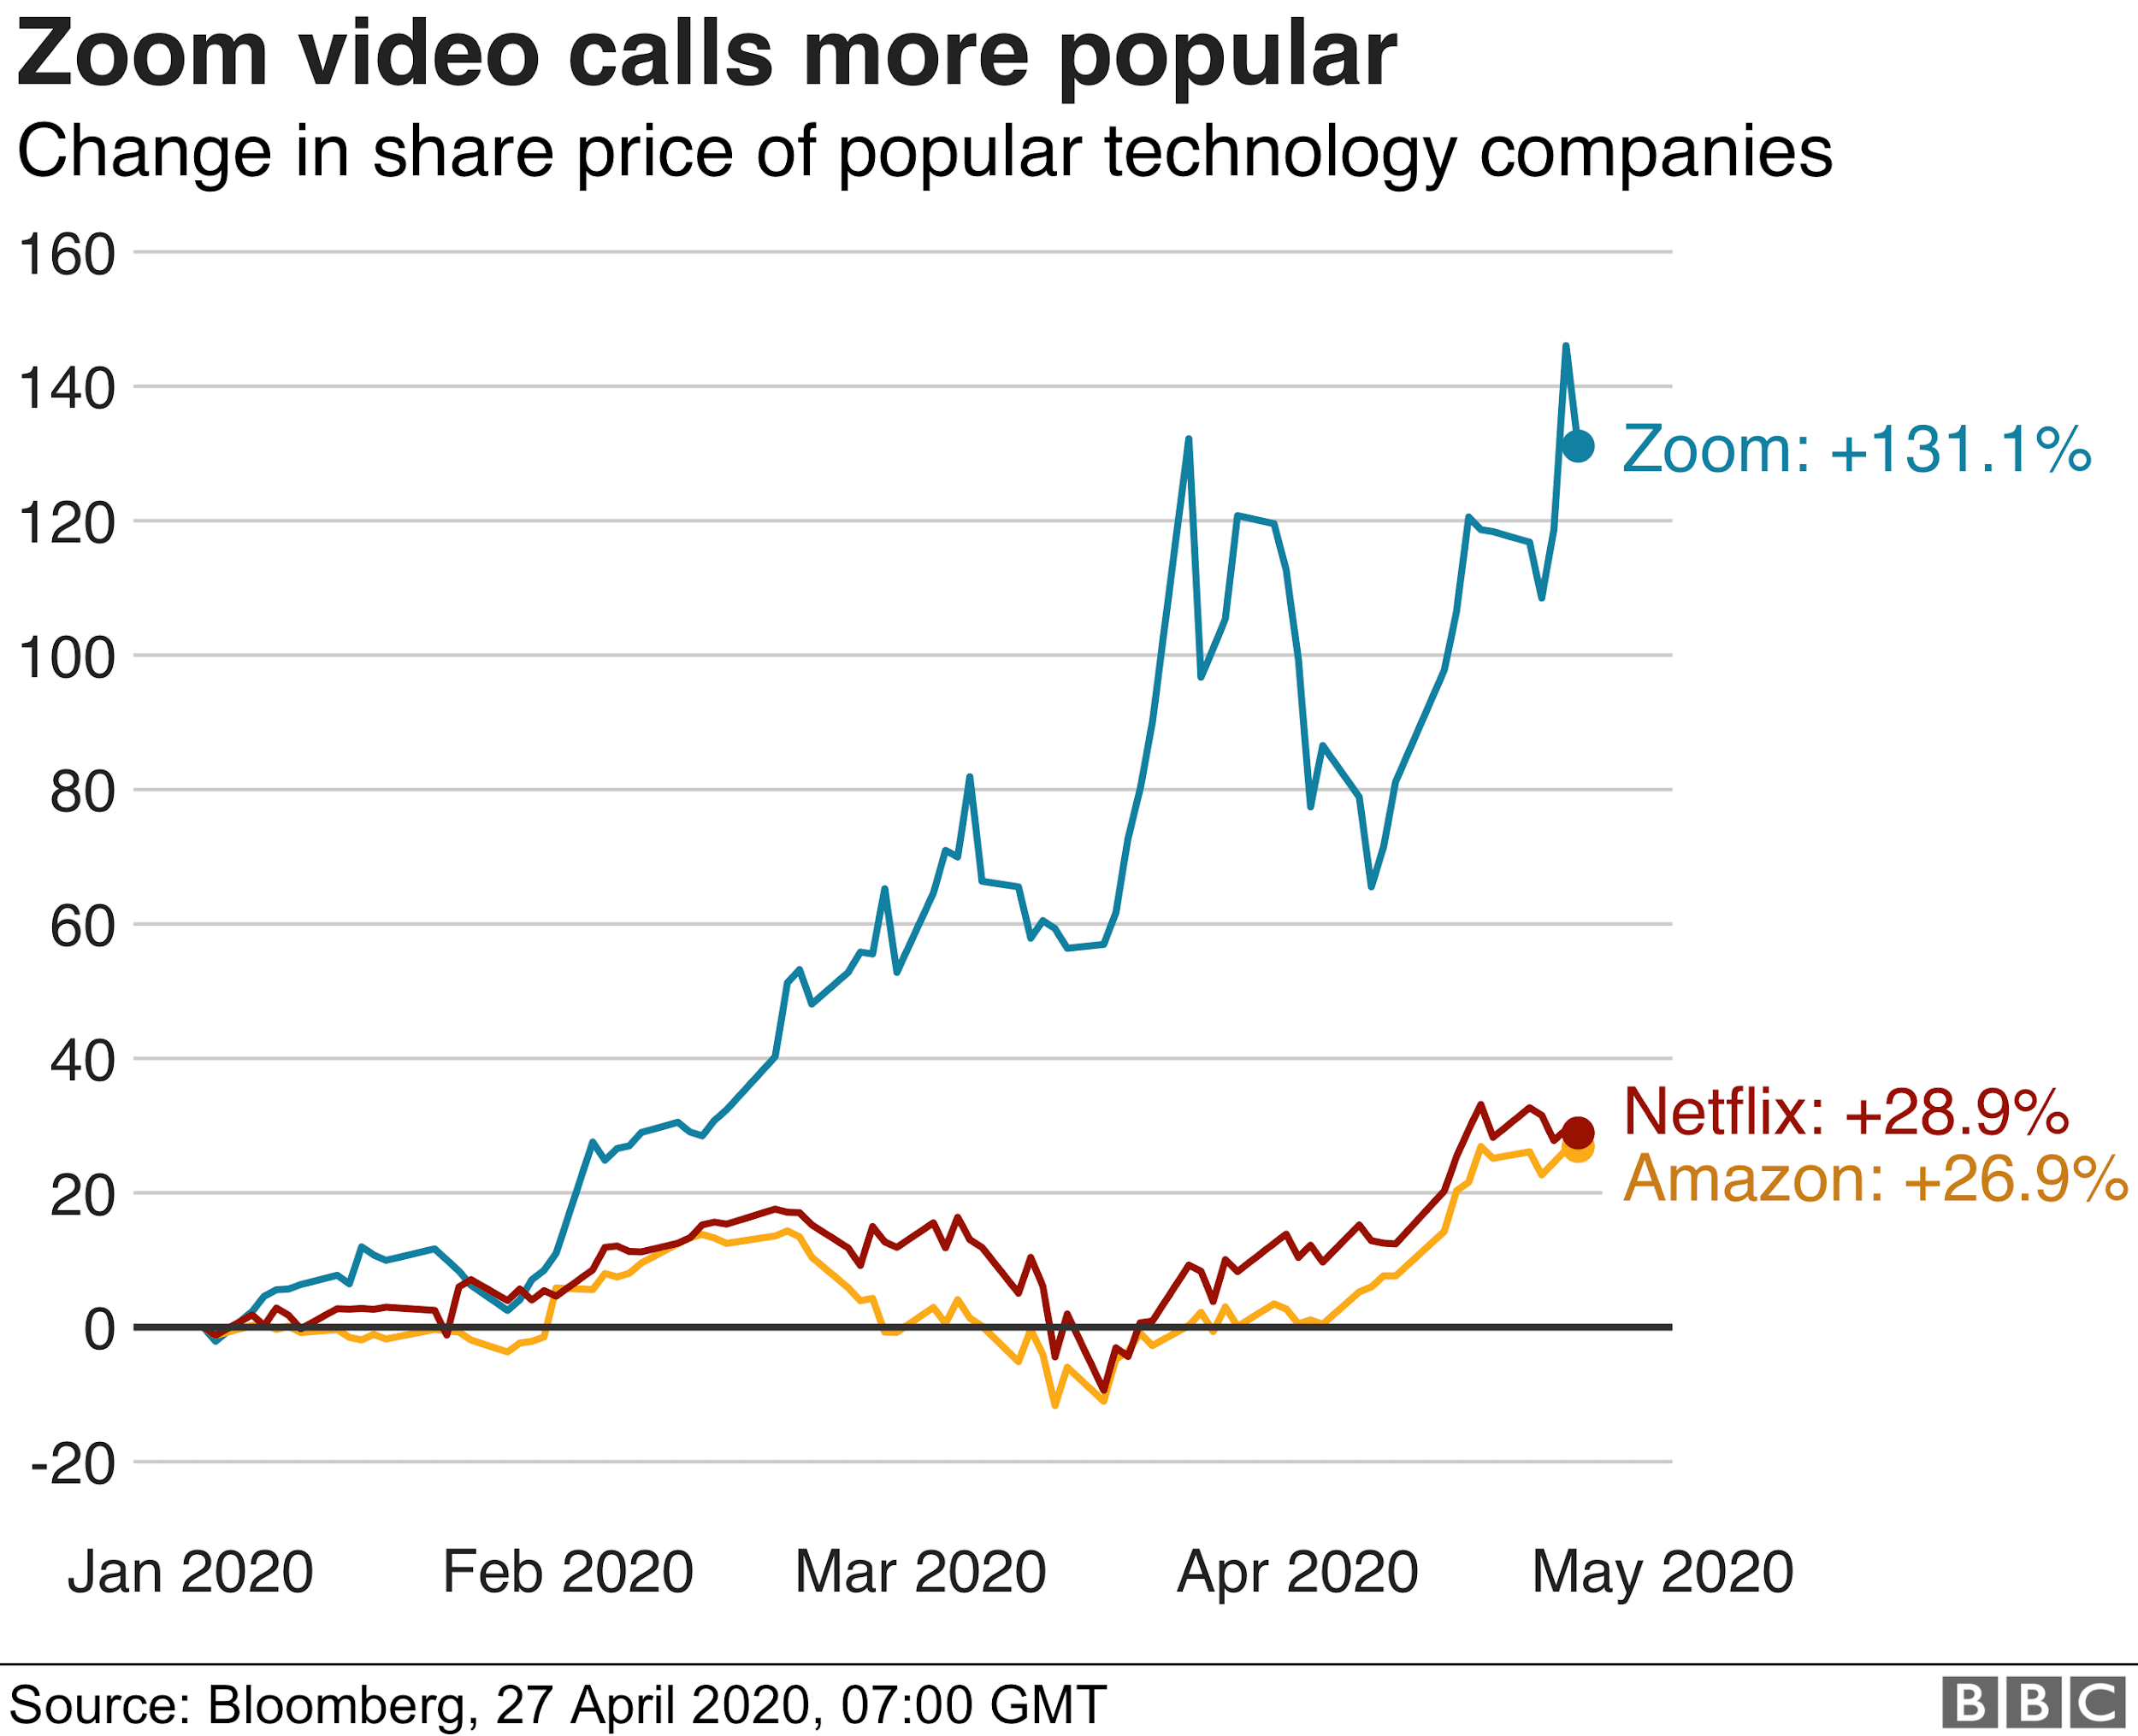
Turn towards video conferencing
Zoom
Cisco WebEx
Google Classrooms
Skype
Twitch
Google Meet

Slide 12

Threats Rise in The Era of COVID
Phishing
Adware
Spyware
Ransomware
CaaS(Crime as a Service)

Slide 13
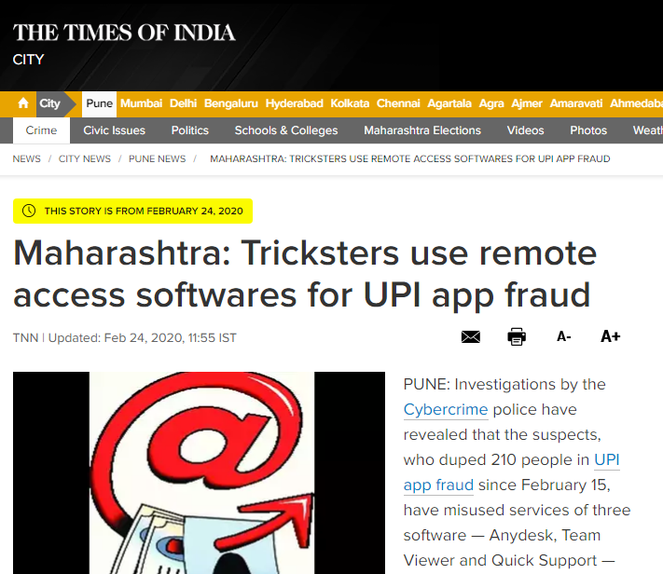
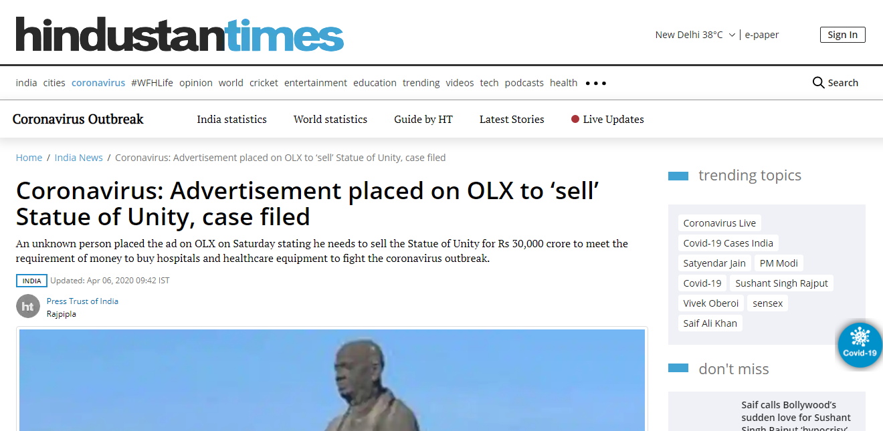
Local News during COVID Lockdown

Slide 14
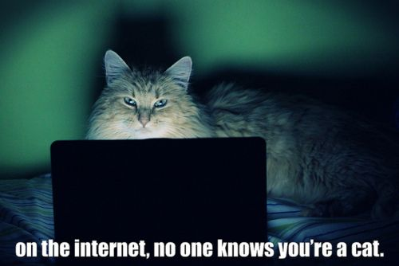
Threat Actors
Cyber Terrorists
State-Sponsored Actors
Organized Criminals
Hacktivists
Insiders
Script Kiddies
Internal Use Errors

Slide 15
“Physical evidence can not be intimidated. It does not forget. It sits there and waits to be detected, preserved, evaluated, and explained.”
-Herbert Leon Macdonell (Quoted at the opening page in his book “The Evidence never lies”)

Slide 16

What is Forensics?
The field of forensic science draws from a number of scientific branches, including physics, chemistry, and biology, with its focus being on the recognition, identification, and evaluation of physical evidence. It has become an essential part of the judicial system, as it utilizes a broad spectrum of sciences to achieve information relevant to criminal and legal evidence.

Slide 17
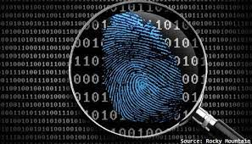
Digital Forensics
Digital forensics (sometimes known as digital forensic science) is a branch of forensic science encompassing the recovery and investigation of material found in digital devices, often in relation to computer crime.

Slide 18
Need for Digital Forensics
Digital forensics is commonly used in both criminal law and private investigation.
Main goal of forensic investigation is evidence of criminal activity.
Attribution
Alibis and Statements
Intent
Evaluation of Source
Document Authentication
When collecting evidence, digital evidence falls in the same category of traditional evidence.

Slide 19
Evidence Gathering
Definition : Evidence is information that comes closest to the facts of a matter.
Prevent contamination
Isolate wireless devices
Install write-blocking software
Select extraction methods
Submit device/media as traditional evidence
Proceed with investigation

Slide 20
Key Challenges faced by Digital Forensics
High speed and volumes
Explosion of complexity
Development of standards
Privacy preserving investigations
Legitimacy
Anti-forensics techniques

Slide 21
What makes Digital Forensics so hard?
Automation and tool gap
Lack of interoperability
Workforce gap
Difficult to integrate with other tools
Multiple tools from multiple vendors

Slide 22
Digital Forensics of Today and Tomorrow
Tailored tools for evidence discovery
Cloud Computing
FaaS(Forensic as a Service)
IoT(Internet of Things) and CPS(Cyber Physical System) to be included for examinations
Low Cost Investigation methods
AI(Artificial Intelligence) for monitoring malicious activity

Slide 23
A few examples of new systems and tools
FaaS(Forensics as a service)
MADIK(Multi-Agent Digital Investigation ToolKit)
SANS SIFT
PRODISCOVER Forensic
The Sleuth Kit (+Autopsy)

Slide 24

The New Normal
Remote working
Use of collaboration tools
Accelerating digital transformation
Moving to Cloud
Automated Production Acceleration
Modern e-Management

Slide 25

Cyber Hygiene
Become vigilant when browsing websites.
Flag and report suspicious emails.
Never click on unfamiliar links or ads.
Use a VPN whenever possible.
Ensure websites are safe before entering credentials.
Keep antivirus/application systems up to date.
Use strong passwords with 14+ characters.

Slide 26
“What’s dangerous is not to evolve.”
Jeff Bezos

Slide 27

Conclusion!

